Slide 1
Topics will Be Covered:
Parallel DC Circuit
Two Elements are in Parallel
Parallel Resistance
Parallel Circuit [Current, Current passing through Different Branch]
Current Divider Rule (CDR)
Kirchhoff’s Current Law (KCL)
Power Distribution in a Parallel Circuit
Series/Parallel Connection of Voltage/Current Sources

Slide 2
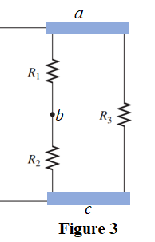
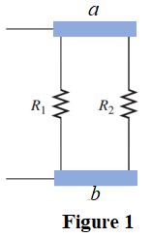
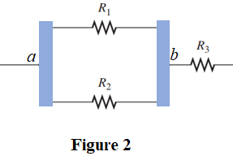
Two Elements are in Parallel
Two elements, branches, or circuits are in parallel:
They have two points in common.
The currents are not the same through the two parallel elements.
The voltage are the same across the two parallel elements.
Figure 3: R₁ and R₂ are in series. The series combination of R₁ and R₂ are parallel with R₃
Figure 1: R₁ and R₂ are parallel since they have two common points a and b.
Figure 2: R₁ and R₂ are parallel since they have two common points a and b. R₃ is series with the parallel combination of R₁ and R_{2.}
2

Slide 3
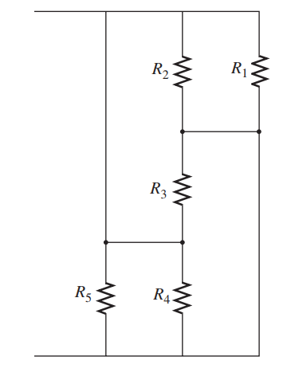
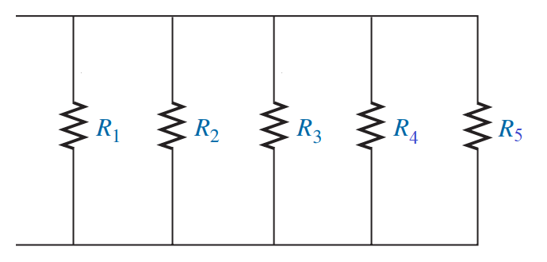
Identify the Combination of Connection for the Following Circuit
a
a
b
b
3

Slide 4
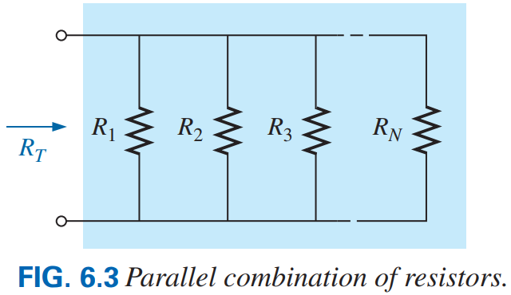

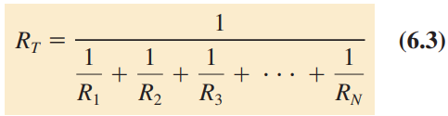
6.2 Parallel Resistance
The total or net or effective or equivalent conductance of a parallel configuration is the sum of the value of individual conductance, that is Eq. (6.2).
The reciprocal of the total or effective or net or equivalent resistance of a parallel circuit is equal to the sum of the reciprocal of the individual resistances, that is Eq. (6.1). Eq. (6.3) can be obtained from Eq. (6.1).
4

Slide 5

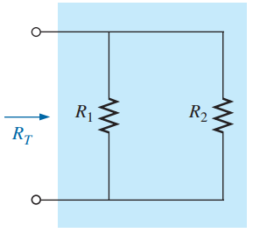
The total or equivalent resistance is the smallest of all the individual resistances. that is Eq. (6.1.1).
The total resistance of n resistors of the same value in parallel is simply divide the value of one of the resistors by the number of resistor in parallel; that is as Eq. (6.4)
Special Case: Two Parallel Resistors
The total resistance of two parallel resistors is simply the product of their values divided by their sum.
5

Slide 6
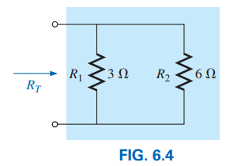
EXAMPLE 6.1
a. Find the total conductance of the parallel network in Fig. 6.4.
b. Find the total resistance of the same network using (i) the results of part (a), (ii) using Eq. (6.3) and (iii) using Eq. (6.5).
Solution:
(ii) Applying Eq. (6.3):
(iii) Applying Eq. (6.5):
6

Slide 7
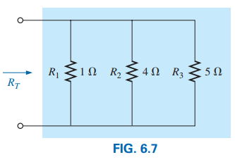
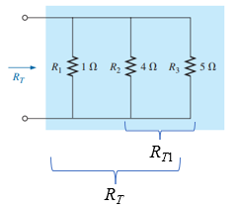
EXAMPLE 6.3 Find the total resistance of the configuration in Fig. 6.7.
Solution: Method 1
Method 2: Applying Eq. (6.3):
Method 2: Applying Eq. (6.5):
7

Slide 8
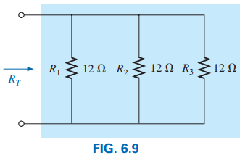
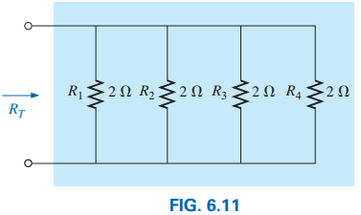
EXAMPLE 6.5 Find the total resistance of the parallel resistors in (i) Fig. 6.9 and (ii) Fig. 6.11.
Solution: In both figures the individual resistance value are equal.
For Fig. 6.9:
R₁ = R₂ = R₃ = R = 12 Ω
For Fig. 6.11:
R₁ = R₂ = R₃ = R₄ = R = 2 Ω
Total resistance: Applying Eq. (6.4):
Total resistance: Applying Eq. (6.3):
8

Slide 9
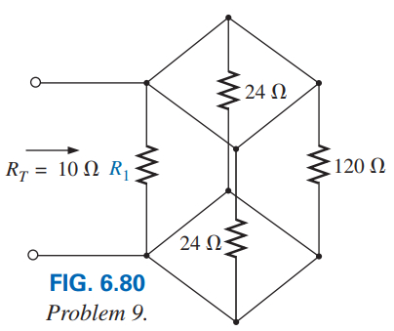
Problem 9 [P. 235] Determine R₁ for the network in Fig. 6.80
Practice Example 6.10 and 6.11
Solution: Here, all resistance are connected in parallel.
a
Let, R₂ = 24 Ω, R₃ = 24 Ω, and R₄ = 120 Ω
a
R₂
a
We know that,
a
b
R₄
b
R₃
b
b
Practice Book Problem [SECTION 6.2 Parallel Resistors] Problems: 1, 3, 4, 5, 7 and 8
9

Slide 10
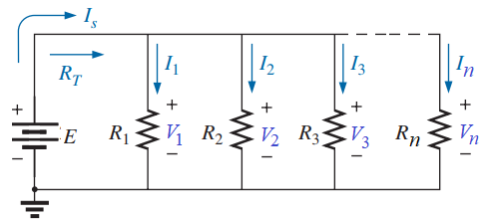

6.3 Parallel Circuit
A parallel circuit is one in which several resistances are connected across one another in such a way that one terminal of each is connected to from a junction point while the remaining ends are also joined to form another junction point.
Voltage in a parallel circuit: the voltage is always the same across parallel elements.
For single-source parallel networks, the source current (I_{s}) is always equal to the sum of the individual branch currents.
Current Calculation of a Parallel circuit: According ohm’s law, the current of the following circuit is as follows:
(6.9)
(6.7)
(6.8)
10

Slide 11
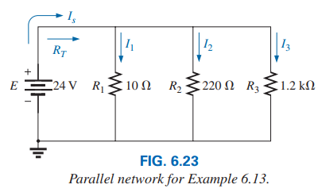
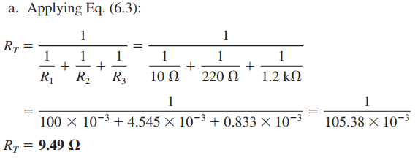
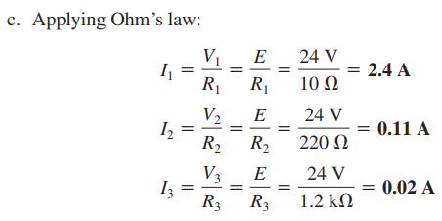
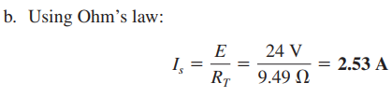
EXAMPLE 6.13 For the parallel network in Fig. 6.23.
a. Find the total resistance.
b. Calculate the source current.
c. Determine the current through each branch.
Solution:

Slide 12
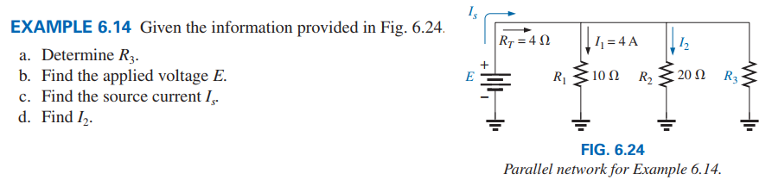
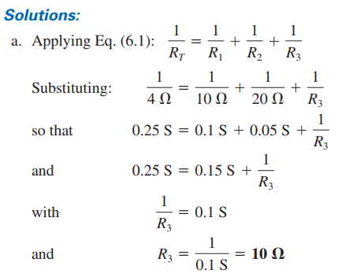



Practice Book Problem [SECTION 6.3 Parallel Circuits] Problems: 10 to 17

Slide 13
6.6 Current Division in Parallel Circuit
Current Divider Rule (CDR)
Current pass through individual resistance in a series circuit : According ohm’s law, the of the following circuit is as follows:
Based on the Eq. (6.14.1) to (16.14.n), a general equation can be written as follows:
(6.8)
Current Divider Rule (CDR): The current through any branch of a parallel resistive network is equal to the total resistance of the parallel network divided by the resistor of interest and multiplied by the total current entering the parallel configuration.

Slide 14
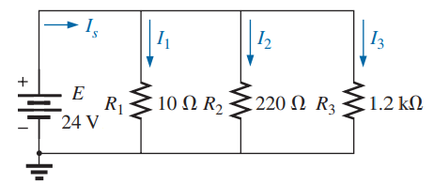
EXAMPLE 6.6.1 For the following parallel network as shown in following figure. Using current divider rule, determine the current through each branch.
Solution:
Applying current divider rule (CDR) Eq. (6.8):

Slide 15
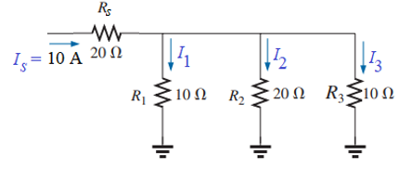
EXAMPLE 6.6.2 For the following parallel network as shown in following figure. Using current divider rule, determine the current through each branch.
Solution:
Applying current divider rule CDR) Eq. (6.8):
Since R₁ and R₃ are equal, the current I₁ and I₃ must be equal.
Since R₂ is twice R₁ or R₃, the current I₂ must be one-half I₁ or I₃.
Practice Book Problem [SECTION 6.6 CDR] Problems: 29 to 34

Slide 16
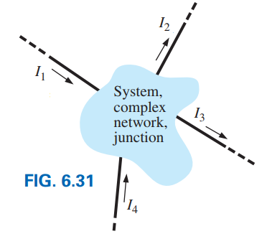
6.5 KIRCHHOFF’S CURRENT LAW (KCL)
Statement:
(1) The algebraic sum of the currents entering and leaving a junction (or region) of a network is zero.
(2) The sum of the currents entering a junction (or region) of a network must equal the sum of the currents leaving the same junction (or region).
(6.13.1)
(6.13)
16

Slide 17
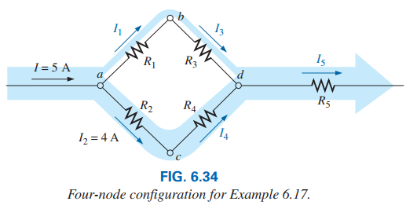
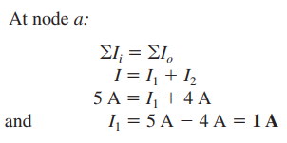
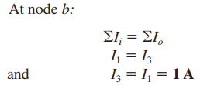
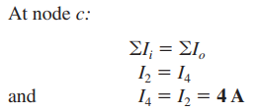
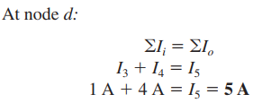
Solution:
17

Slide 18

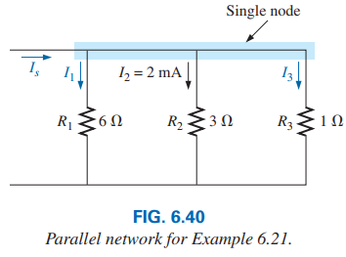
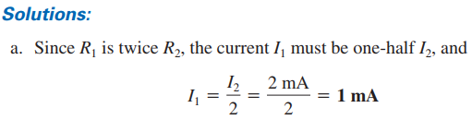

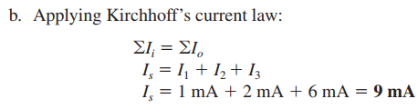
18

Slide 19
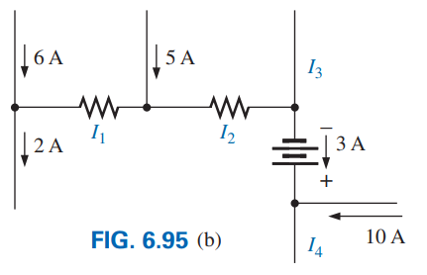
Problem 25 [P. 238] Using Kirchoff’s current law, find the unknown currents for the complex configurations in Fig. 6.95(b).
Solution: Consider four (a, b, c, and d) nodes are here.
a
c
At node a: 6 A is entering and 2 A is leaving so consider I₁ is leaving.
b
According to KCL at node a, we have: 6 A = I₁ + 2 A = 9 A
∴ I₁ = 6 A − 2 A = 4 A
d
At node b: I₁ = 4 A and 5 A are entering so consider I₂ is leaving.
According to KCL at node b, we have: I₂ = 4 A + 5 A = 9 A
At node c: I₂ = 9 A current is entering and 3 A is leaving so consider I₃ is leaving.
According to KCL at node c, we have: 9 A = I₃ + 3 A ∴ I₃ = 9 A − 3 A = 6 A
At node d: 3 A and 10 A are entering so consider I₄ is leaving.
According to KCL at node d, we have: I₄ = 3 A + 10 A = 13 A
Practice Book Problem [SECTION 6.5 KCL] Problems: 24 to 28
19

Slide 20
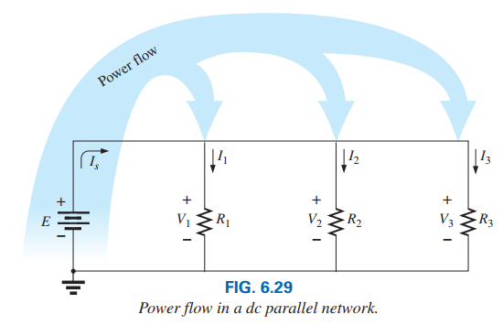
6.4 Power Distribution in a Parallel Circuit
In any electrical system, the power supplied or applied or delivered will equal the power dissipated or absorbed or consumed.
(6.10)
(6.11)
(watt, W) (6.12)
20

Slide 21
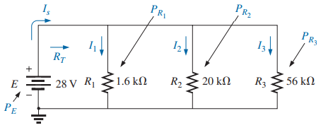
EXAMPLE 6.15 For the parallel network in Fig. 6.30:
a. Determine the total resistance R_{T}.
b. Find the source current (I_{s}) and the current (I₁, I₂, and I₃) through each resistor.
c. Verify KCL.
d. Calculate the power delivered by the source.
e. Determine the power absorbed by each parallel resistor.
f. Verify Eq. (6.10)
Solution:
21

Slide 22
b. Find the source current (I_{s}) and the current (I₁, I₂, and I₃) through each resistor.
22

Slide 23
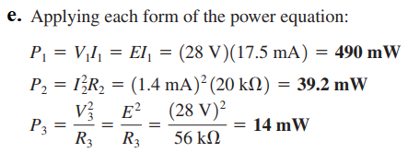

d. Calculate the power delivered by the source.
e. Determine the power absorbed by each parallel resistor.
f. Verify Eq. (6.10)
Solution:
Practice Book Problem [SECTION 6.4 Power Distribution]
Problems: 19 to 23
23

Slide 24
SERIES/PARALLEL
CONNECTION OF
VOLTAGE/CURRENT SOURCES
24

Slide 25
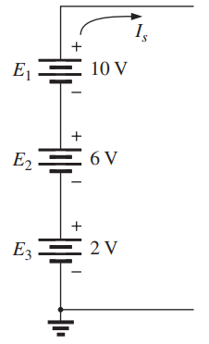
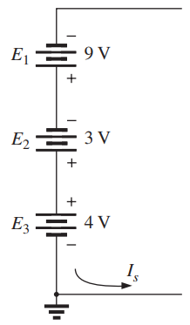
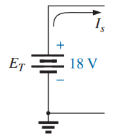
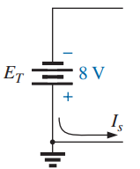
VOLTAGE SOURCES IN SERIES
Voltage sources can be connected in series.
The voltage sources to be connected in series must have same current ratings through their voltage rating may be same or different.
Fig. 5.3 Reducing Series Voltage Sources to a Single Source

Slide 26
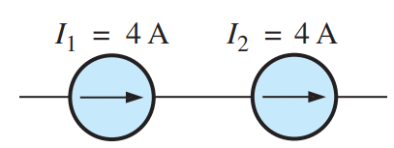
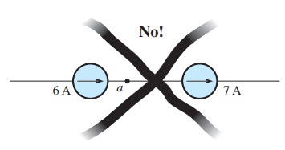
CURRENT SOURCES IN SERIES
Current sources to be connected in series must have same current ratings through their voltage ratings may be same or different.
OK
Current sources of different current ratings should not be connected in series.
26

Slide 27
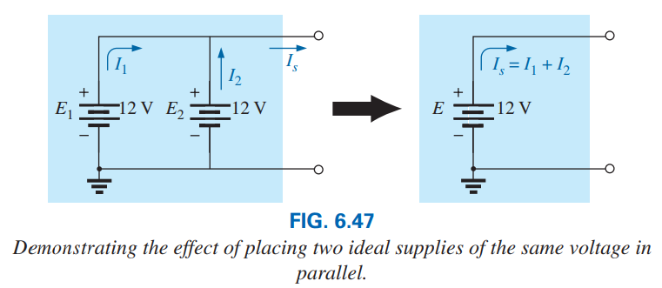
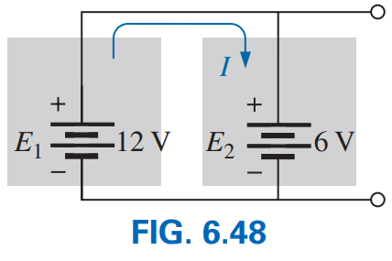
6.7 VOLTAGE SOURCES IN PARALLEL
Voltage sources can be placed in parallel only if:
(i) They have the same voltage rating.
(ii) Positive terminal should be connected with positive terminal and Negative terminal should be connected with negative terminal
Voltage sources to be connected in parallel must have same voltage rating through their current rating may be same or different.
OK
NO
Should not be connected
27

Slide 28
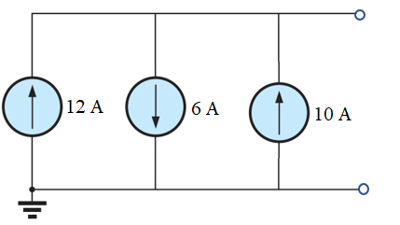
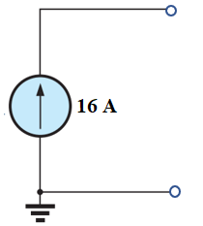
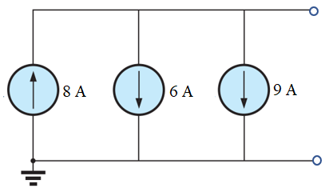
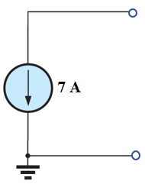
CURRENT SOURCES IN PARALLEL
Current sources of different current ratings are not connected in series.
The current sources to be connected in parallel must have same voltage rating through their current ratings may be same or different.
Reducing Parallel Current Sources to a Single Source
28

Slide 29
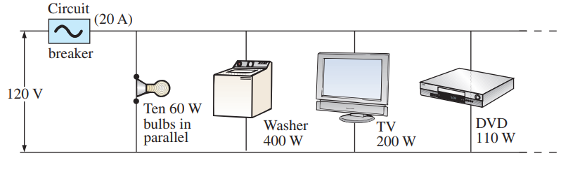
Problem 22 [P. 238] A portion of a residential service to a home is depicted in Fig. 6.92.
a. Determine the current through each parallel branch of the system.
b. Calculate the current drawn from the 120 V source. Will the 20 A breaker trip?
c. What is the total resistance of the network?
d. Determine the power delivered by the source. How does it compare to the sum of the wattage ratings appearing in Fig. 6.92?
Solution: a. We know that:

Slide 30
b. Calculate the current drawn from the 120 V source. Will the 20 A breaker trip?
c. What is the total resistance of the network?
d. Determine the power delivered by the source. How does it compare to the sum of the wattage ratings appearing in Fig. 6.92?
b. Applying KCL we have:
Since source current less than 20 circuit breaker will not trip.
Power delivered by the source (P_{E}) is equal to the sum of the wattage ratings (P_{w}).

